Slide 1
UI Development: Visualforce and Lightning Components
What you must know…
Andrés Pérez
Master Technical Instructor, Salesforce University
@ELTOROIT

Slide 2
Forward-Looking Statements
Statement under the Private Securities Litigation Reform Act of 1995:
This presentation may contain forward-looking statements that involve risks, uncertainties, and assumptions. If any such uncertainties materialize or if any of the assumptions proves incorrect, the results of salesforce.com, inc. could differ materially from the results expressed or implied by the forward-looking statements we make. All statements other than statements of historical fact could be deemed forward-looking, including any projections of product or service availability, subscriber growth, earnings, revenues, or other financial items and any statements regarding strategies or plans of management for future operations, statements of belief, any statements concerning new, planned, or upgraded services or technology developments and customer contracts or use of our services.
The risks and uncertainties referred to above include – but are not limited to – risks associated with developing and delivering new functionality for our service, new products and services, our new business model, our past operating losses, possible fluctuations in our operating results and rate of growth, interruptions or delays in our Web hosting, breach of our security measures, the outcome of any litigation, risks associated with completed and any possible mergers and acquisitions, the immature market in which we operate, our relatively limited operating history, our ability to expand, retain, and motivate our employees and manage our growth, new releases of our service and successful customer deployment, our limited history reselling non-salesforce.com products, and utilization and selling to larger enterprise customers. Further information on potential factors that could affect the financial results of salesforce.com, inc. is included in our annual report on Form 10-K for the most recent fiscal year and in our quarterly report on Form 10-Q for the most recent fiscal quarter. These documents and others containing important disclosures are available on the SEC Filings section of the Investor Information section of our Web site.
Any unreleased services or features referenced in this or other presentations, press releases or public statements are not currently available and may not be delivered on time or at all. Customers who purchase our services should make the purchase decisions based upon features that are currently available. Salesforce.com, inc. assumes no obligation and does not intend to update these forward-looking statements.

Slide 3
UI Development: Visualforce and Lightning Components
What are we doing?
Understanding Visualforce and Lightning Components basics.
Preparing for the Platform Developer I certification
What are we not doing?
Becoming UI Developer gurus.
What does that mean?
Don't worry about the syntax for every character in the code
Worry about understanding general ideas / concepts
Check full code details later in Github (@ELTOROIT)

Slide 4
Visualforce
What you must know…
@ELTOROIT

Slide 5
MVC
Model-View-Controller
Data
Navigation
Standard UI
Page Layouts
Tabs
Visualforce
View
Salesforce writes…
Standard Controller
You write… (Apex)
Custom Controllers
Controller Extensions
Controller
sObjects
Custom
Standard
Model

Slide 6
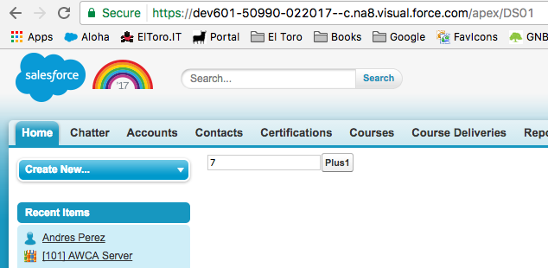
Sample #1 (DS01: A simple counter)
What are we building?
Button invokes Apex for counter increment
Textbox for counter
URL: /apex/PageName

Slide 7
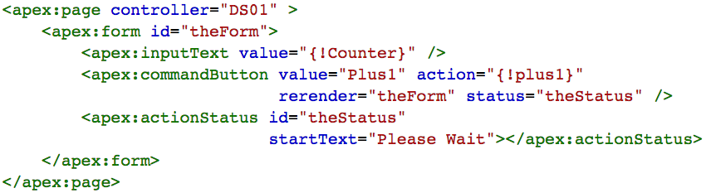
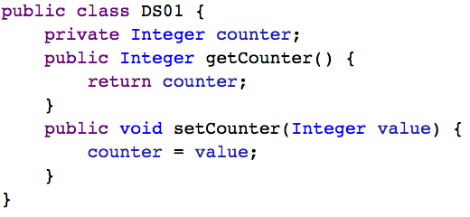
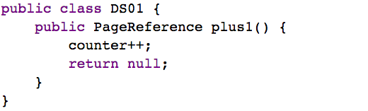
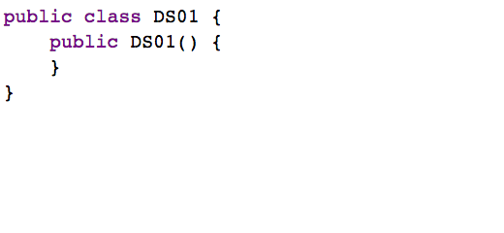
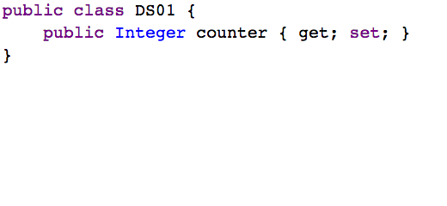
Sample #1 (DS01: A simple counter)
Counter's value is
managed by Apex
DS01 is Apex custom controller
Apex method that will increment counter
Button
Textbox
Visualforce Page and custom controller
7 Lines for a simple textbox? Are you kidding me???

Slide 8
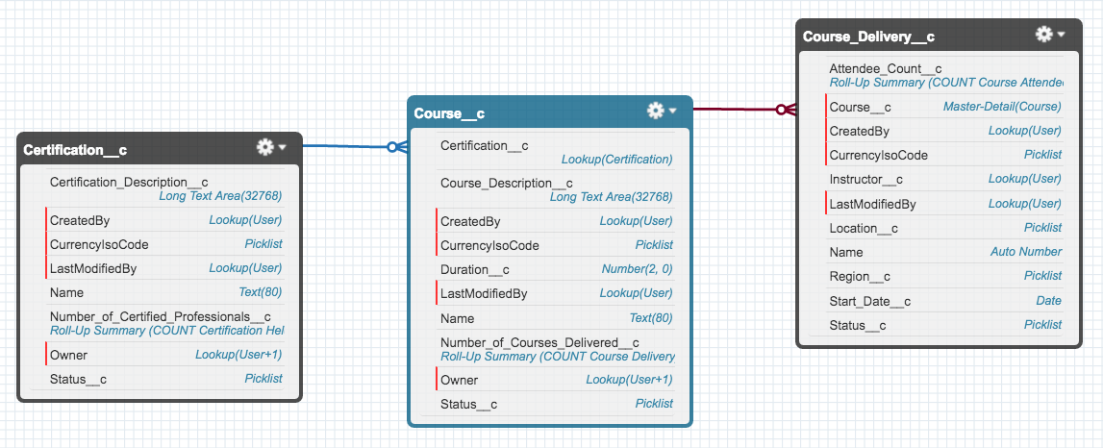
Sample #2 (DS02: Let's get some data)
Review data model

Slide 9
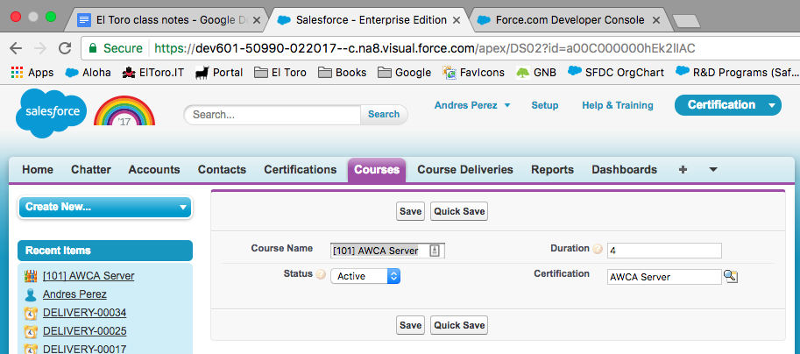
Sample #2 (DS02: Let's get some data)
What are we building?
Save and QuickSave buttons
Some fields…
URL has the record Id (15/18 characters)
With custom controller, you must
write SOQL and DML in Apex !

Slide 10
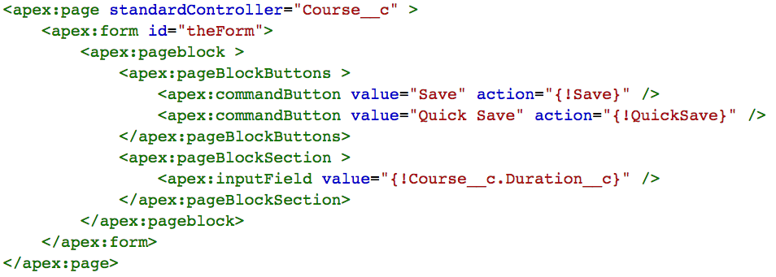
Sample #2a (DS02: Let's get some data)
Using standard controller
Standard controller
has action methods
Standard controller
has getters and setters
Visualforce code
Standard controllers will help write less Apex
Available for custom and standard sObjects

Slide 11
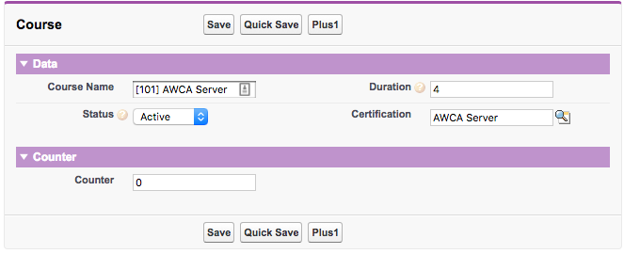
Sample #2b (DS02: But I want Apex!)
What are we building?
and custom logic
I want data…

Slide 12
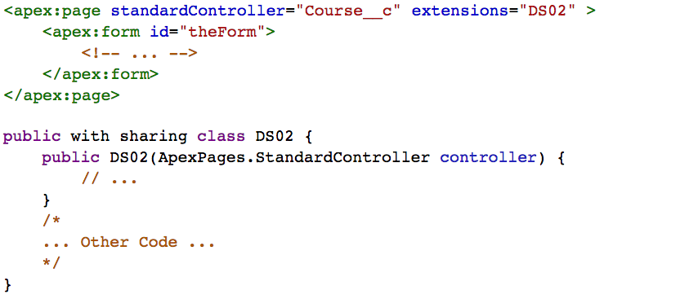
Sample #2b (DS02: But I want Apex!)
Controller is passed
to the extension
Using standard controller
Using extension (Apex)
Standard Controller + Apex = Extensions !

Slide 13
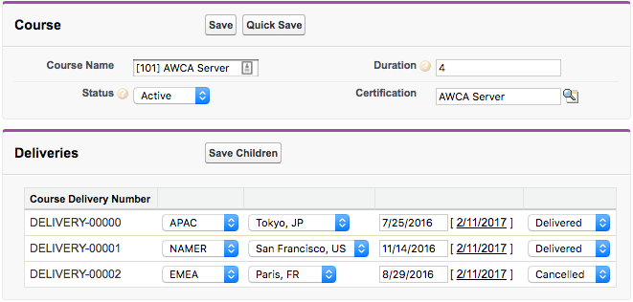
Sample #2c (DS02: Controller's data in Apex Controller)
What are we building?
and save children
I want to save course data…
Standard controller can't save children!
Mr. Controller, I want your data so I can save it….

Slide 14
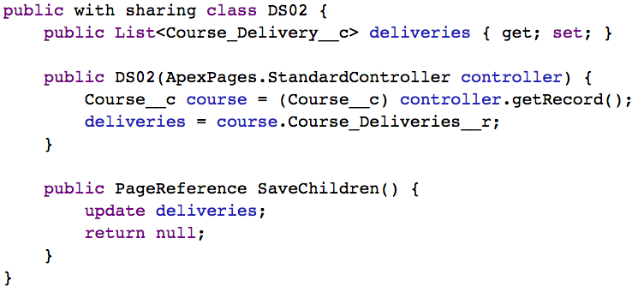
Sample #2c (DS02: Controller's data in Apex Controller)
You can get the course record
You can get the children
and then save it ;-)
Standard Controller + Apex = Extensions !

Slide 15
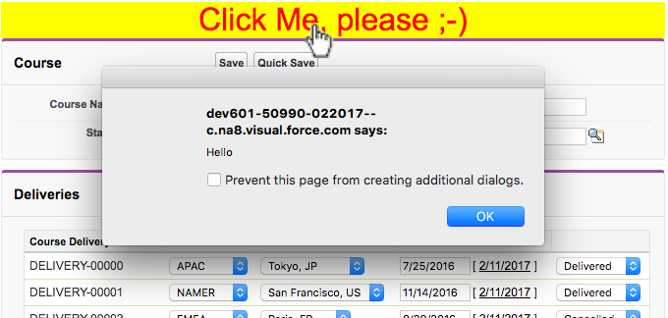
Sample #2d (DS02: I want HTML/CSS/JavaScript)
What are we building?
HTML, CSS, Javascript

Slide 16
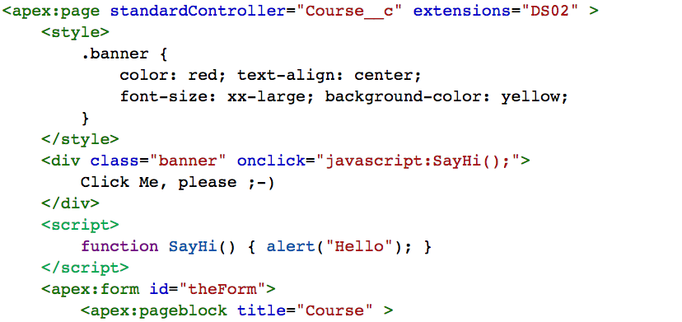
Sample #2d (DS02: I want HTML/CSS/JavaScript?))
JavaScript
HTML
CSS
Visualforce can have HTML, CSS and JavaScript

Slide 17
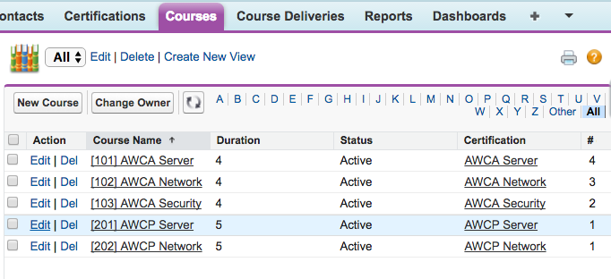
Sample #2e (DS02: So, how can I use Visualforce?)
Overriding standard actions
When I click edit a course…

Slide 18
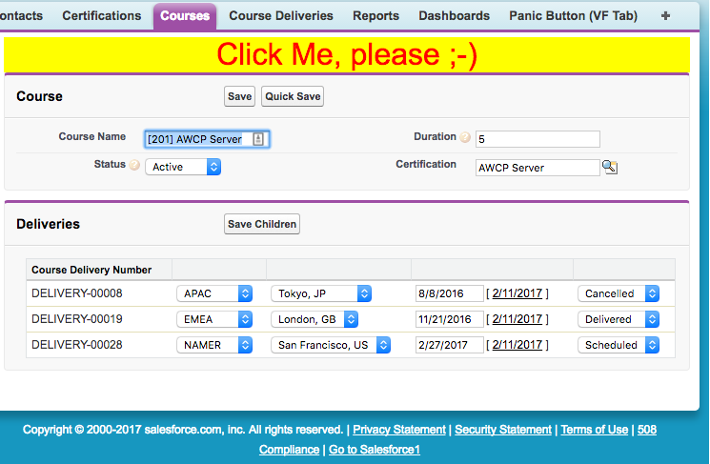
Sample #2e (DS02: So, how Can I use it?)
Go to my Visualforce page
I want to see my Visualforce page

Slide 19
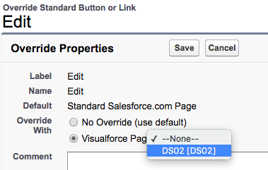
Sample #2e (DS02: So, how can I use it?)
Where can I use it?
Visualforce pages can be used …
In a custom Tab
Inside Salesforce1
Within a standard Page Layout
Inside a Lightning Page (Lightning App builder)
To override standard action (buttons)
Using custom buttons or links
Typing the URL
In many more places
How to override a standard action?
Edit sObject's button
Where are the other Visualforce pages?
Must use a standard controller for that sObject

Slide 20
Lightning Components
What you must know
@ELTOROIT

Slide 21
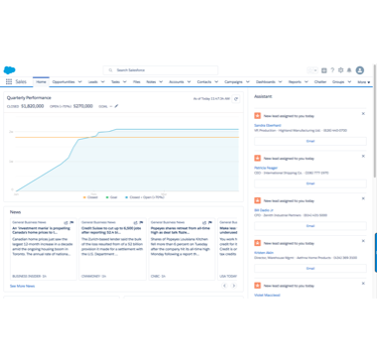
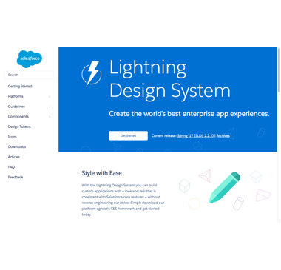
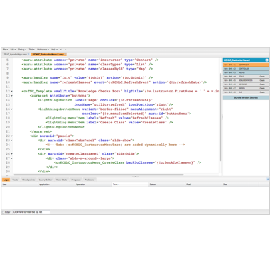
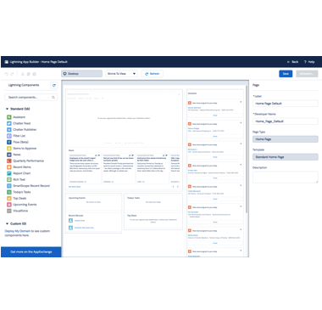
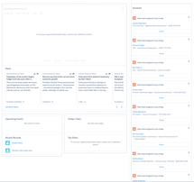
What's this Lightning thing?
Lightning means few things in Salesforce
Lightning Experience
Lightning Design System
Lightning Components and Applications
Lightning App Builder
Lightning Pages
Lightning Component Framework

Slide 22
Lightning Components Framework
Options when developing for Salesforce1 / mobile
Native Visualforce
Transfers ViewState on every call to server
Too many server round trips
Runs inside iframe in Salesforce1
HTML5 inside Visualforce page
You write lot's of HTML / CSS
No easy connection to Salesforce for data
Must use APIs or Remote Apex
Runs inside iframe in Salesforce1
Lightning Components
Fast performance at runtime for users, and fast to develop
Slow performance at runtime for users, but fast to develop
Fast performance at runtime for users, but slow to develop

Slide 23
Lightning Components Framework
Benefits
Faster performance at runtime
Stateful client and stateless server
No need for unnecessary round trips to server
No need to pass ViewState
Client manages state
Data is passed in JSON
Server does not return full HTML, just data
Efficient use of client and network resources
Including server, browser, devices, and network
Faster development
Rich OOTB component set, designed for any device
Salesforce1, communities and Lightning Experience
No need to worry about HTML / CSS
AppExchange For Components
Components can be installed from AppExchange
You don't have to do all the heavy work
Decoupled components using events
Publisher / subscriber model
Parallel development for teams
Multiple developers in single project !
OOP applied to the UI !

Slide 24
Lightning Components Framework
More benefits
Design Lightning Experience pages using App Builder and Community builder
Modify standard pages, not just Page Layouts
Include your own components or components downloaded from AppExchange
Easily build for Salesforce1, Lightning Experience, and Communities
Modern Web technology
Build device-aware and cross browser compatibility applications
Uses HTML5, CSS3, responsive design, touch events, etc.

Slide 25
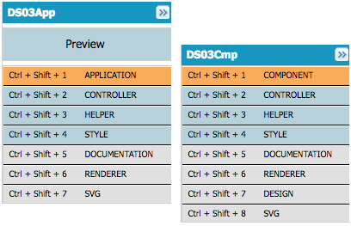
Lightning Components And Applications
What's a bundle?
Each component or application is organized in a "folder" with multiple "files"
Markup (components or applications)
Controller (JavaScript)
Helper (JavaScript)
Style (CSS)
Documentation (Markup)
Renderer (JavaScript)
Design
SVG (Icon for Lightning App Builder)

Slide 26
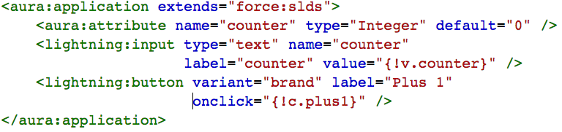
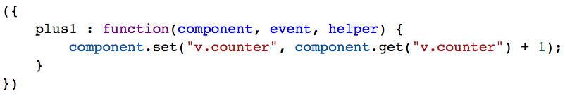
Lightning Components And Applications
Defines the action function
Calls action method
Button
Textbox
Defines a variable
Increment counter
Uses variable
Show me the code
No need for Apex, because there is no sObject data being used !

